Slide 1
An Examination of Male/Female Roles and Relationships in the Diaspora compared to Traditional African Culture
Presented by Mrs. Nakia Hinkle-Jawara
Bachelor of Science- Loyola University Chicago- Social Work/Psychology; African American Studies- Minor
Master of Arts in Teaching- Freed Hardeman University

Slide 2
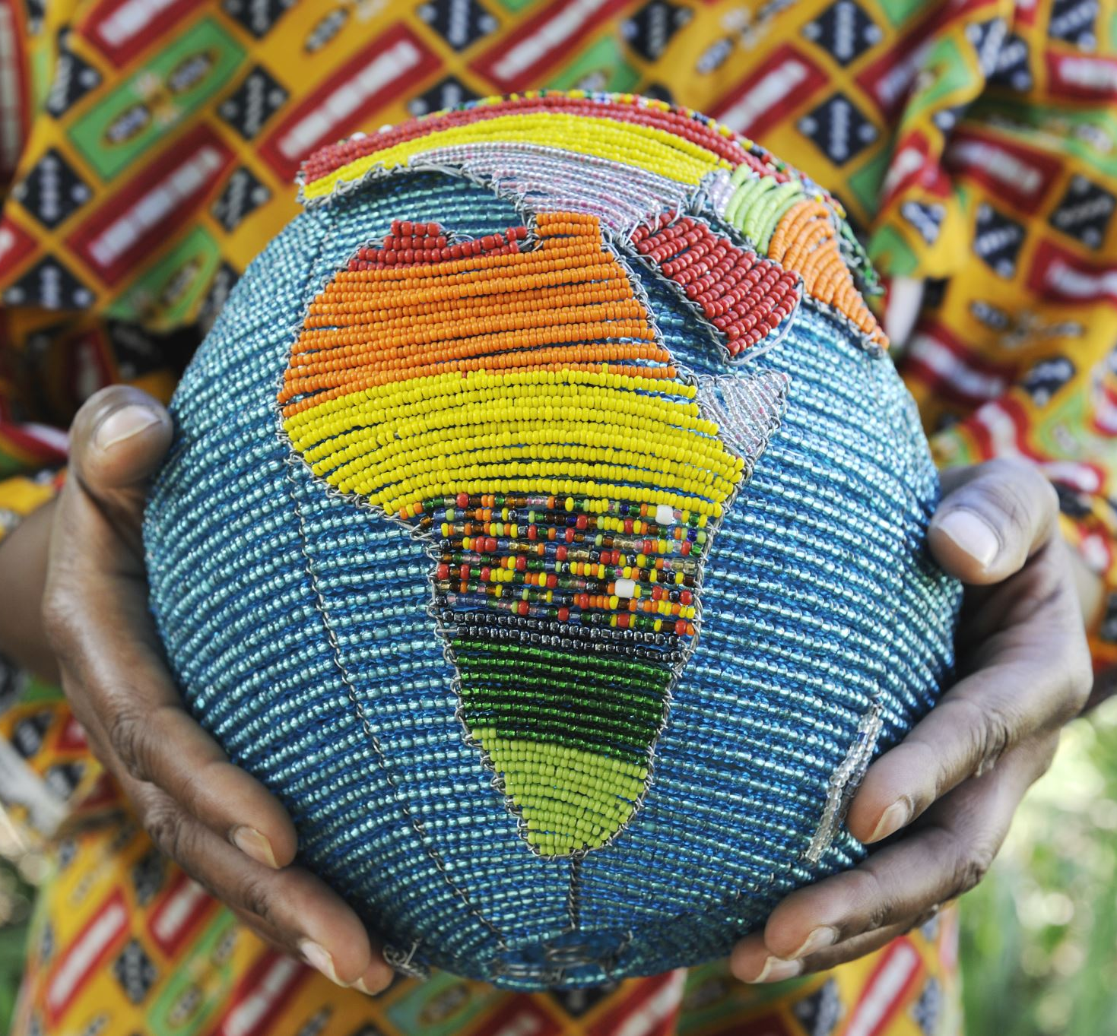
Objective
This presentation will not approach the topic of discussion as Africa vs the Diaspora, but rather a comparison of common changing values across cultures. We will look at similarities and differences to determine how we can move forward as we make connections to bridge the gap between Africa and her scattered descendants worldwide.

Slide 3
Then and Now
We will discuss changes we see in the Diaspora, and on the African continent as it relates to relationships, marriage, and traditional male/female roles.
2. The Black African diaspora in the Americas consists of those of us who are descendants of fore parents who were enslaved or free in the Americas which consists of North America- Canada, the United States, Mexico, Central America, The Caribbean islands, and South America.

Slide 4
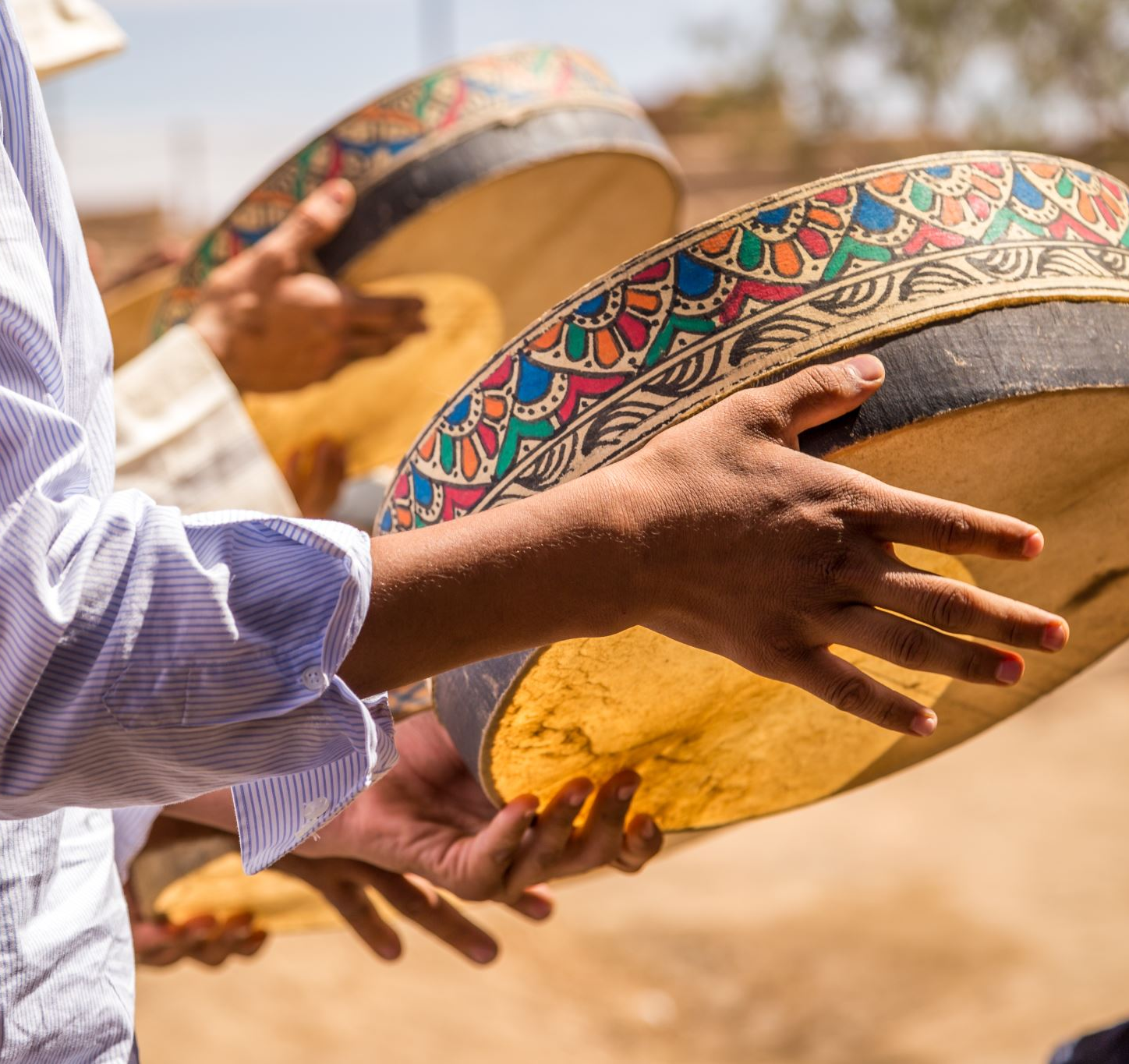
Defining the African Diaspora
1. The African Diaspora consists of all African descendants living anywhere on Earth that left Africa at some point in time.
2. For the sake of this discussion, we will specifically on the Diaspora that descend from those who were forcibly taken away during the Middle Passage or Trans Atlantic slave trade and how aspects of our cultures evolved in the places where our ancestors landed.

Slide 5

Events that disrupted our traditional culture of relationships
1. Colonization
2. Slavery and the slave trade
3. Religions that came from outside of us
Jim Crow and other racist discriminatory systems in place
5. Integration
6. Multiculturalism
7. Globalization

Slide 6
Traditional African core family values
Importance of extended family and community
Respect for Elders
Dominant Male presence and family head
Clearly defined roles for male and female
Rights of Passage into manhood and womanhood
Marriage is an important aspect of traditional life
Marriage marks the bringing of families together
Marry within one’s own tribe
Often a dowry is paid as a bride price
Men are expected to provide for the women and children
Big families are valued and represent wealth and prosperity
Fertility is highly prized
Polygamy is often accepted and valued because it leaves no women alone. All women are accounted for in terms of having a mate and being provided for.

Slide 7
Core values of Black Culture in the Diaspora (Then)
Importance of extended family and community
Respect for Elders
Dominant Male presence, but if he’s absent a Dominant Female exists
Clearly defined roles for male and female but may change if the need arises.
Rights of passage may include a talk with a parent or grandparent or older person
Marriage is an important aspect of traditional life
Marriage marks the bringing of families together, but in laws often are more distant
Marry within the known community or marry into any good family
Men are expected to provide for the women and children, but women are most likely expected to help out in some way
Big families are valued but typically seen as a burden- more mouths to feed.
Monogamy is the ideal and preferred. Although many affairs and liaisons exist off record.

Slide 8
Present day changing values (Now) in Africa
Less important to marry within one’s tribe
Paying a dowry is not practiced by everyone anymore
Relocation and emigration out of one’s home country and community.
Support of family is through financial means, not as much physical
Women becoming more educated
Women working with their own income
Marrying outside of one’s culture and country
Use of birth control, thereby reducing birth rates
Divorce becoming more common
Younger people are staying single longer
Some children are being born out of wedlock

Slide 9
Present day changing values in the Black Diaspora
Abandonment of the Traditional family roles
Embracing of Feminist ideals
Struggle to accept traditional roles of the man as the head of the family
Women becoming more educated and generating income
Lower birth rates- children seen as expensive or an obstacle to having a career
Men assuming less responsibilities because women are making money
Marriage has become monetized, and many people feel they cannot ”afford” to get married.
The single life is often glorified in popular culture as being less stressful and carefree.

Slide 10
3 Factors that led to the changes of the Male/ female roles in Africa and the Diaspora
Colonization has existed in Africa and created an unequal distribution of wealth and the exploitation of Africa’s resources and thereby affected relationships.
Slavery in the Diaspora completely ripped apart male female relationships. Black Women were seen as sexual objects only and breeders. Men were used as studs and worked to death. Many of our men who resisted were killed right away or forced into horrible punishments.
Globalization is affecting all of us in that we no longer see our own cultures as important.

Slide 11
Lasting Impact Now and for the Future
We need to examine the way we’ve evolved in our perspective of marriage, and male /female roles
Decide if the changes have been for the better or the decline of our communities in Africa and the Diaspora in America.
Make changes to implement those ideals that were working or are working for us at some point
Encourage someone else and don’t forget about the Youth

