Slide 1
EVOLUTION OF CAMEROON TERRITORY
FROM THE GERMAN PROTECTORATE, THE PARTITION, THE REUNIFICATION, THE UNIFICATION TO THE UNITARY STATE
(From 750 000 Km2 to 475 442 Km2 of today)
BY
Ahmadou SEHOU, PhD
University of Ngaoundere
Phone/WhatsApp: +237 656 96 58 53
E-mail: asehou@gmail.com

Slide 2
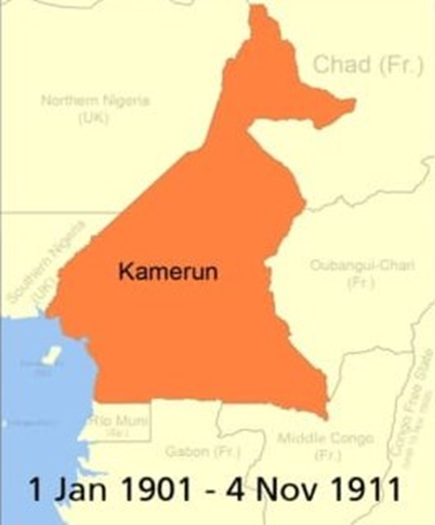
A creation of the Germans
12 july 1882 : Signing a protection treaty with the Duala kings
Conquests in the coastal area
Conquests of the interior
Conquests of the Adamawa
From the Atlantic to the Lake Chad in the North
From the Atlantic to the Congo basin in the East

Slide 3
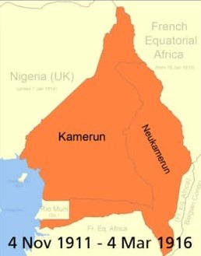
From Kamerun to Neukamerun
Negotiations with the French colonizers in the East
Exchange of territories in Morocco and Equatorial Africa
Enlargement of Kamerun territory (part of Chad, Part of CA and part of Congo)
750 000 Km2

Slide 4
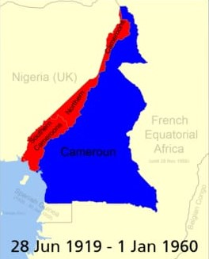
Cameroon under a dual Mandate of the League of Nations
From 1916 to 1919: period of Anglo-French Condominum
1916: Partition of the Territory
1/3 for the British (Cameroons under British mandate)
¾ for the French (Cameroun under French mandate)
1945 : End of WW2
The Cameroons under British Trusteeship
The Cameroun under French Trusteeship

Slide 5
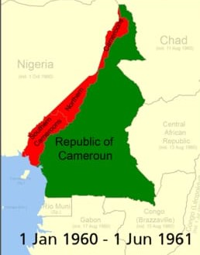
DECISION TIME
1st Jan 1960 : Proclamation of Independance for Cameroun under French administration
Creation of the Republic of Cameroun
The Cameroons under British administration remains until 1st October 1960 when Nigeria become Independant
What future for the British Cameroons (between Nigeria and Republic of Cameroun)
Organisation of two separate plebiscite on 11th and 12th Feb 1961 for decision (to join Nigeria or to join Republic of Cameroun)
NO 3rd OPTION !

Slide 6
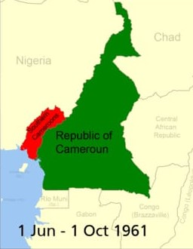
The FEDERAL REPUBLIC OF CAMEROON
From 1st October 1961 to 20th May 1972
One Federal President and Vice-President
Two States
Three Governments
Four Assemblies
Two official languages (French and English)

Slide 7
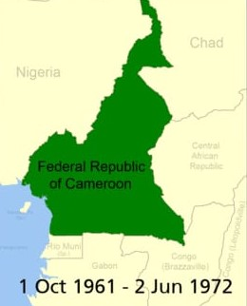
The UNITED REPUBLIC OF CAMEROON
Referendum of 20th May 1972
Establishing a Unitary State
07 Provinces
One Head of State
One Government
One Assembly
One party system from 1966
Nov 1982: President Ahmadou Ahidjo step down, replaced by Paul Biya
1984 : Decision to change the name of the country by law / recent roots to the Anglophone Crisis
Republic of Cameroon is born (which is the name for only French Cameroun in 1960 !)
10 Provinces / Regions
58 Divisions
360 Subdivisions / Municipalities
Back to Multipartism in 1990
The Bakassi crisis (1994-2002)
The Anglophone Secessionnist Crisis (from October 2016)
Next presidential election on October 2025

Slide 8
