Slide 1
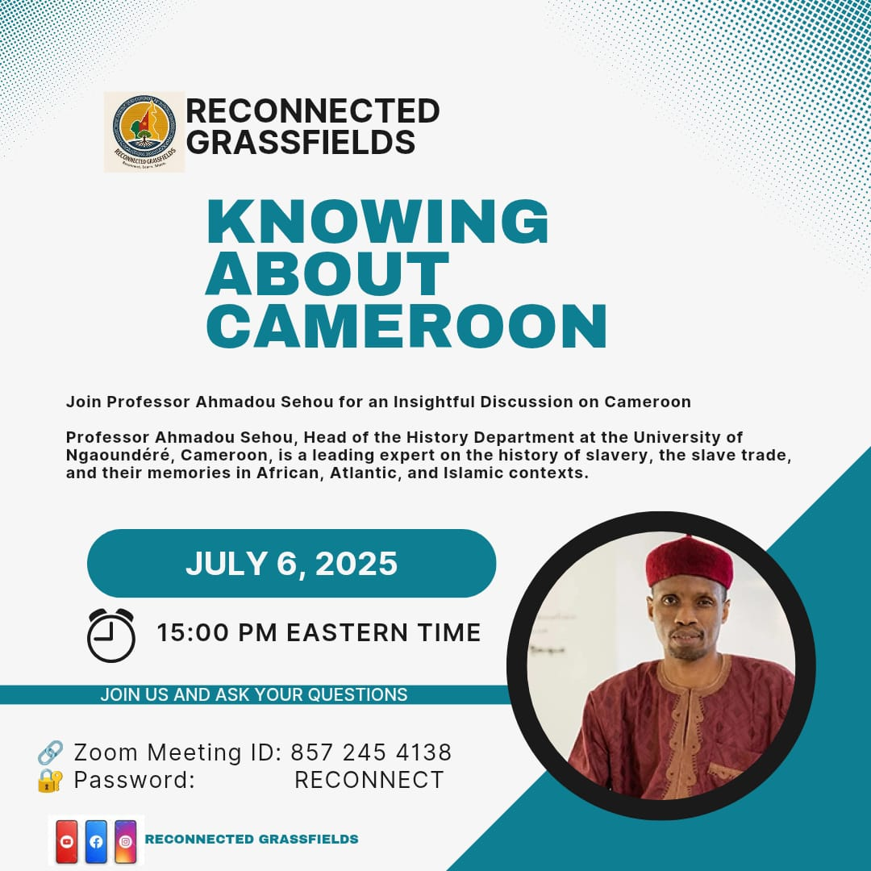

Slide 2
CAMEROON POLITICAL SCENE IN 2025
Territory of about 475 000 KM2
Population estimated at 30 millions people
Independance: since 1st Jan 1960 and 1st Oct 1961
Reunification on 1st October 1961 (Federal bilingual state)
Unification on 20th May 1972 (Unitary state, one party system since 1st september 1966)
Back to multiparty system in Dec 1990 (Multiparty system from 1948 to 1966; 88 political parties in 1960)
About 380 legalised political parties today

Slide 3
POLITICAL SYSTEM
PRESIDENTIALISM (division of power branches but dominant Head of State)
EXECUTIVE: President of the Republic, Prime Minister, Ministers and Assistants or Deputy ministers
LEGISLATIVE: Parliament (National Assembly of 180 members, Senate of 100 members)
JUDICIARY: Supreme Court, Courts and Tribunals
CONSTITUTIONAL COUNCIL of 11 members designated for 6 years renewable
ELECTIONS CAMEROON (electoral board)

Slide 4
POLITICAL FORCES / REPRESENTATION
ADMINISTRATIVE STRUCTURES
National level: Presidency, Government, Parliament, Judiciary, CC
Regional level: 10 Regions, 10 Regional councils, 58 Divisions
Local level: 360 Municipal councils, 360 Sub-divisions
POLITICAL REPRESENTATION
Few political parties are represented (18)
VOTERS REGISTERED: 8 250 000

Slide 5
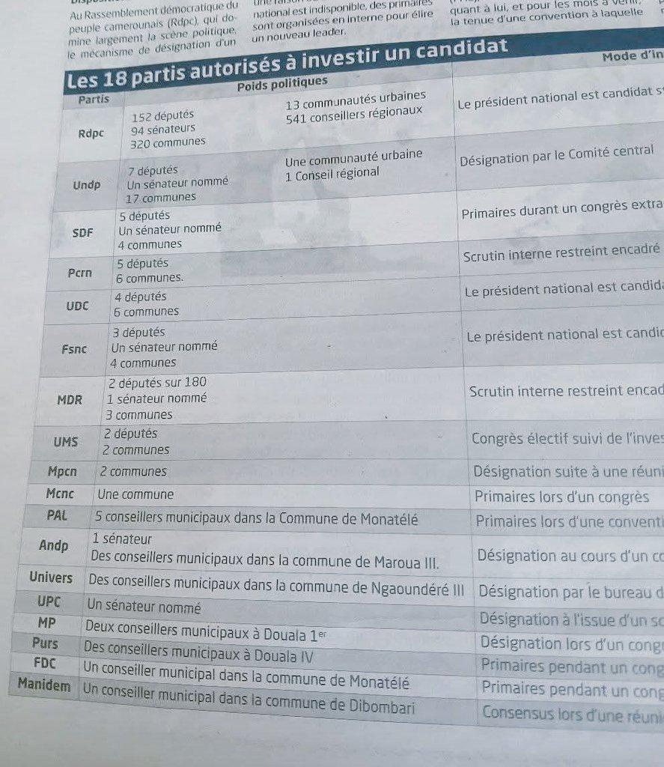

Slide 6
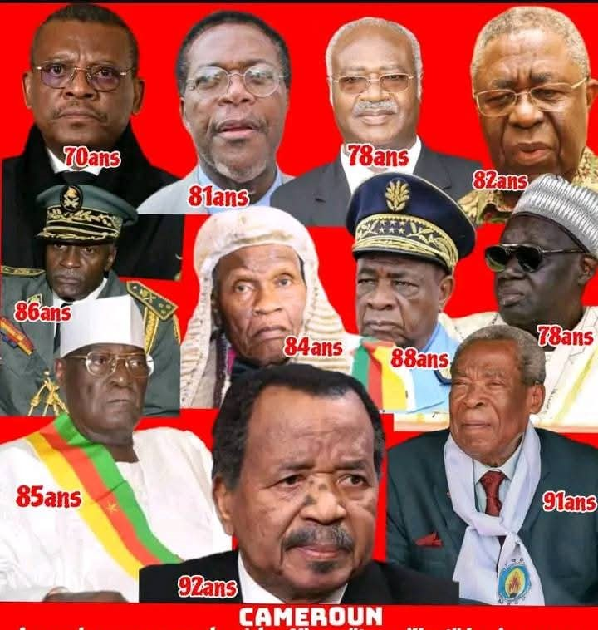

Slide 7
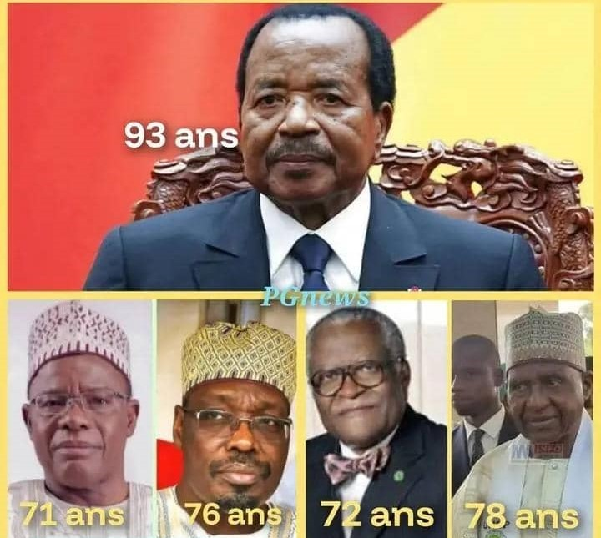
LEADING CANDIDATES FOR 2025

