Slide 1
THE FANG-BETI GROUP OF CAMEROON
THE EWONDO PEOPLE

Slide 2
WHO ARE THE FANG-BETI OR EKANG PEOPLE ?
The Fang-Beti people are a Central African ethnic group primarily found in central Cameroon.
They are also found in Equatorial Guinea and northern Gabon.
They are closely related to the Bulu people, the Fang people and the Yaunde people or EWONDO, who are all sometimes grouped as Ekang.
The Beti are found in northern regions of their joint demographic distribution areas (Central Cameroon), the Fang in the southern regions (Gabon, Equatorial Guinea/BUBI), and others (BULU, NTUMU) in between.

Slide 3
LOCATION AND SETTLEMENTS
From the Atlantic coastal regions near Equatorial Guinea into the hilly, equatorial forest covered highlands of central Africa reaching into the Congo.
Estimates of the total Beti population at over three million.
They likely moved into equatorial Africa in the seventh or eighth century, then further southwest in central Cameroon between the seventeenth and nineteenth centuries, likely after waves of wars and slave raids from the Tchamba and Fulani.
Their initial migration in the 17th century was from highlands and forested regions east of the Sanaga River towards south and west.
They were also a targeted source for slaves and ivory.
They abandoned their settlements and migrated further into southern parts of central Cameroon till the 19th century when European traders and colonial forces intervened as they sought trade and markets.
The first European power to create a colony that partly included the lands of the Beti people was the German Kamerun colony from 1884.

Slide 4
ECONOMIC AND SOCIAL ORGANIZATION
The traditional occupation of the Beti/Ewondo people is farming, particularly of yams, cassava, corn and plantains as staples.
Since colonial times, many have adopted cash crops such as peanuts and cacao.
They are skilled artists and craftsmen, particularly in iron and wood handicrafts. However, these craftsmanship are nearly extinct because of urbanization and modern trade flows.
The traditional Beti society has been organized at the village level, typically with its borders fenced and fortified with watch towers to protect the inhabitants from wild life of the rain forests and intruders.
Outside the village compounds were carefully concealed traps, as another line of defense against slave raiders.
The villages have tended to be politically independent of each other, centered on a lineage called Ayon or Mvog.
They are a patrilineal people, and disputes are typically settled by a due process led by a headman.
The Beti revere their ancestors, and known among other things for their artistically produced reliquary boxes called the Byeri. They store the bones of their ancestors in these reliquary boxes, which were used during rites of passage, with their sophisticated masks called So (animal-faced) and Ngil (human-faced).
The Beti people practise double exogamy, that is typically married away from both father's and mother's lineages. Another notable aspect of their society has been the concept of Mebala, a type of potlatch, where wealthy families ceremoniously gather and give away their wealth to the poorer families.

Slide 5
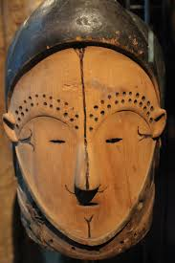
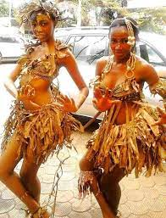
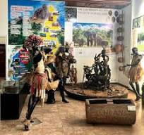
CULTURAL LIFE

Slide 6
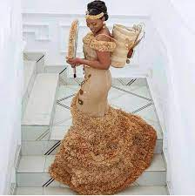
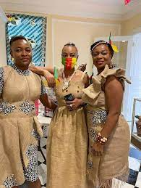
CULTURAL LIFE

Slide 7

