Slide 1
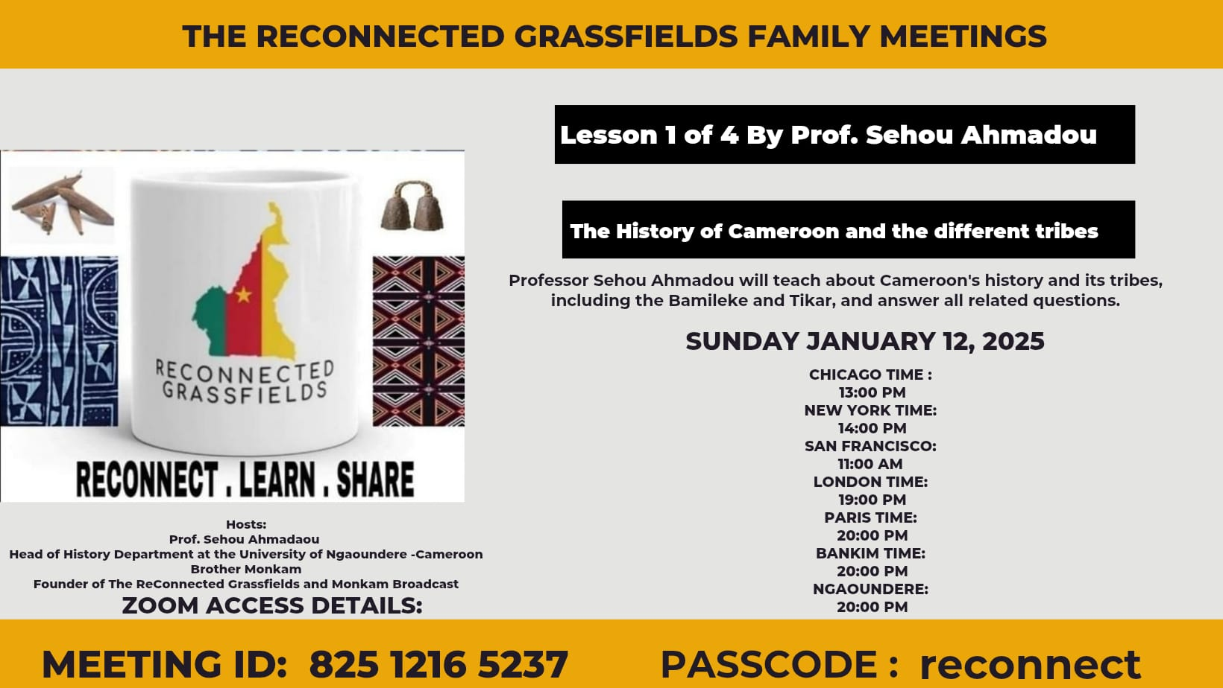

Slide 2
“Water the roots and the branches will grow” African proverb
“Those who reject their ancestors will be rejected by their descendants” African wisdom

Slide 3
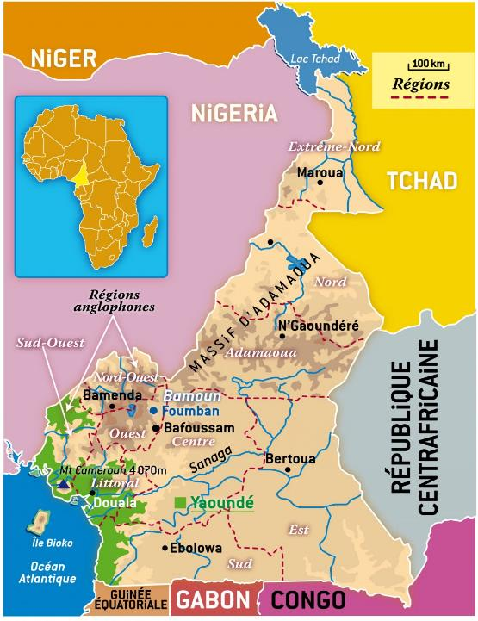
Location: from the Atlantic Ocean (at the bottom of the Gulf of Guinea) to Lake Chad

Slide 4
Origins: … Camerounian space
On the coast (until the arrival of the Portuguese in the 15th century) and then the English in the 18th century
Fishing peoples (Sawa: duala, isubu, bakweri, banyang, mbo...) migrating along the coast or following the banks of rivers (Campo, Nyong, Lokoundje, Sanaga, Wouri, Moungo...)
Clanic structures (extended families);
Practice of exogamy (sometimes abduction of women);
Limited contacts with the peoples of the forest interior (Pygmies, Bassa, Bakoko, Ngumba, Bakossi, Abo, Bakundu, Yabassi, Bamileke, Bamoun, Widikum, Nso, Tikar, Banen, Béti, Ntumu, Fang...);
Very limited conflict (brawls, fights between youths, etc.); social reintegration of prisoners into the community
From Lake Chad to the edge of the forest
Fishermen around Lake Chad and along rivers such as the Logone, the Chari, the Benue (Kotoko, Mousgoum, Tupuri ...);
Farmers (Wandala, Tupuri, Moundang, Mofou, Matakam, Guiziga, Guidar, Fali, Sara, Dama, Dowayo, Dii, Mboum, Gbaya, Péré, Vouté, Tikar, Wawa, Kondja, Kaka, Maka....)
Kotoko principalities (Sao); Musgum cities with their obus huts; Mboum chiefdoms around caves and mountains (Ngan-Ha, Ngawkor, Ngaouhora, Ngaoundéré, Ngaoundal); Vouté cities;
Political structures on the scale of clans or lineages; practice of exogamy (abduction of women), material culture (ceramics, pottery, smithy, architecture, handicrafts...)
No evidence of slavery or slave markets in the social structure or in oral traditions before the introduction of Islam from the North or the arrival of the Portuguese on the Atlantic coast in 1472.

Slide 5

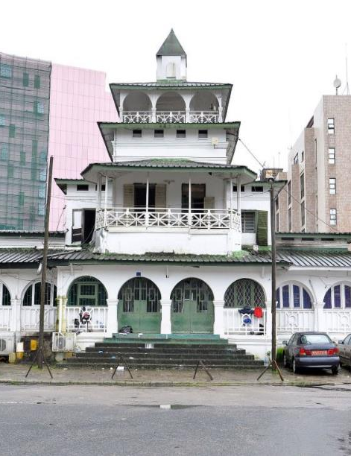
Banks of the Wouri (most important trading site),
The pagoda: Palace of King Akwa in Douala

Slide 6
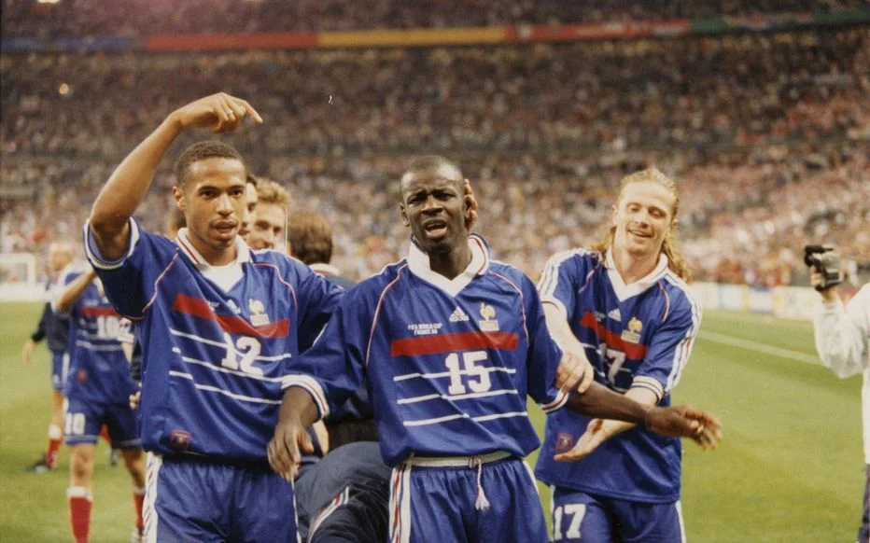
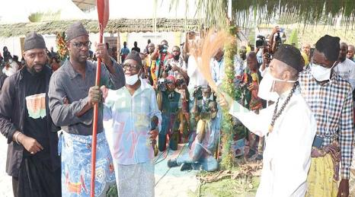
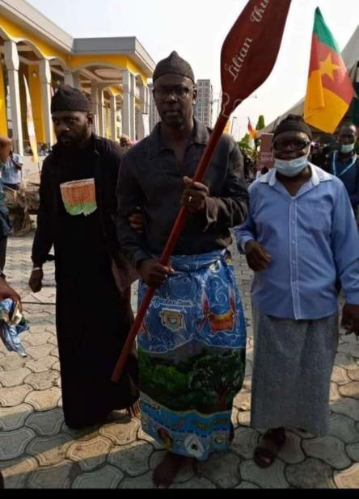
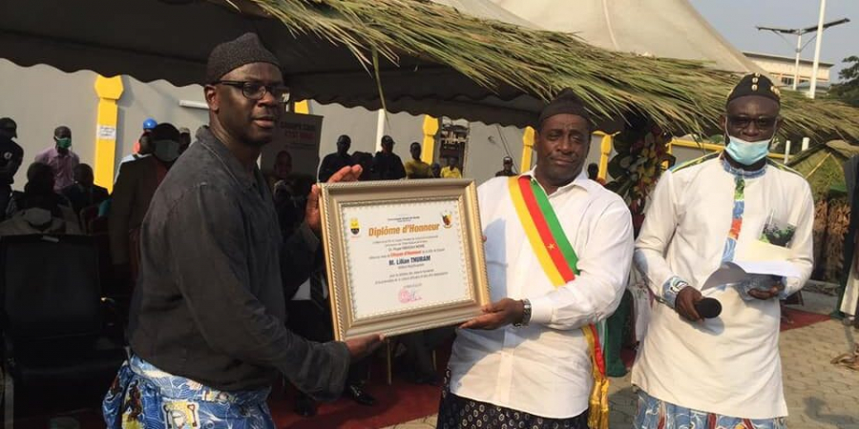
January 21, 2021: Lilian Thuram, 1998 world soccer champion with the French national team, made notable sawa (he is from the duala ethnic group of Jebale Island according to his DNA)

Slide 7
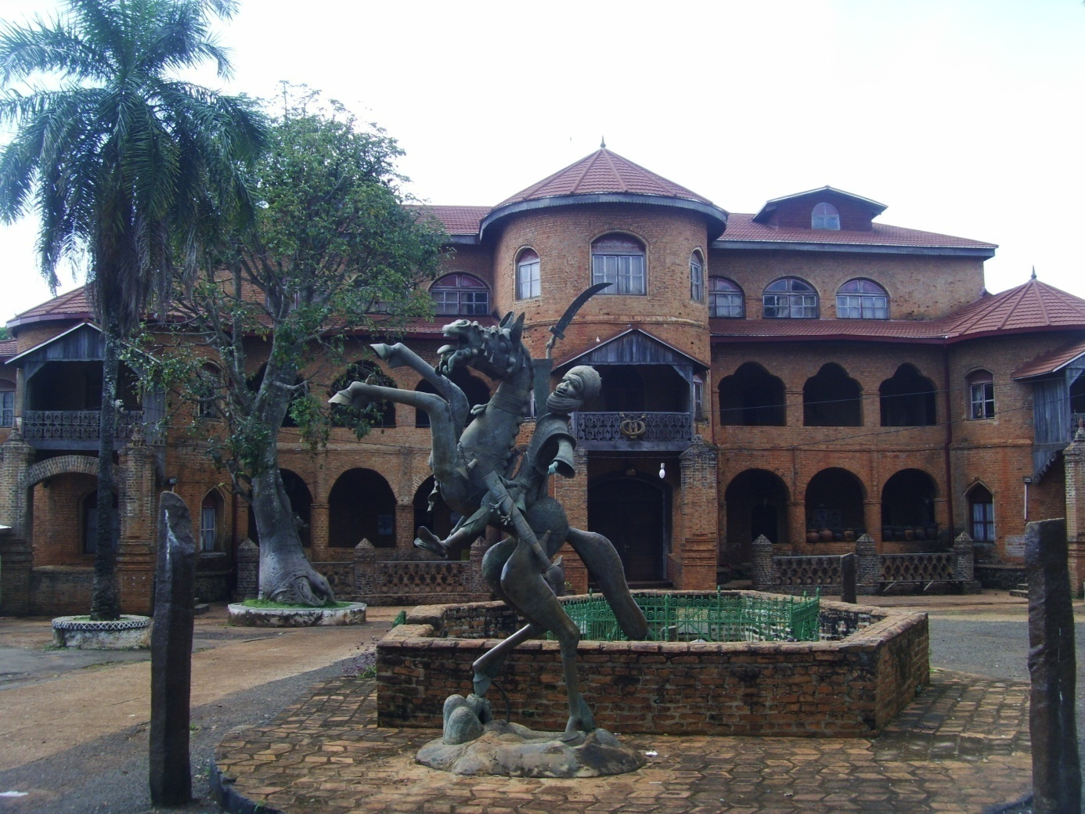
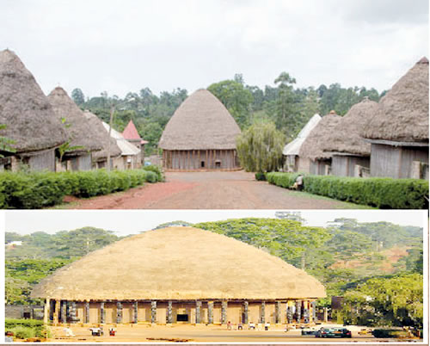
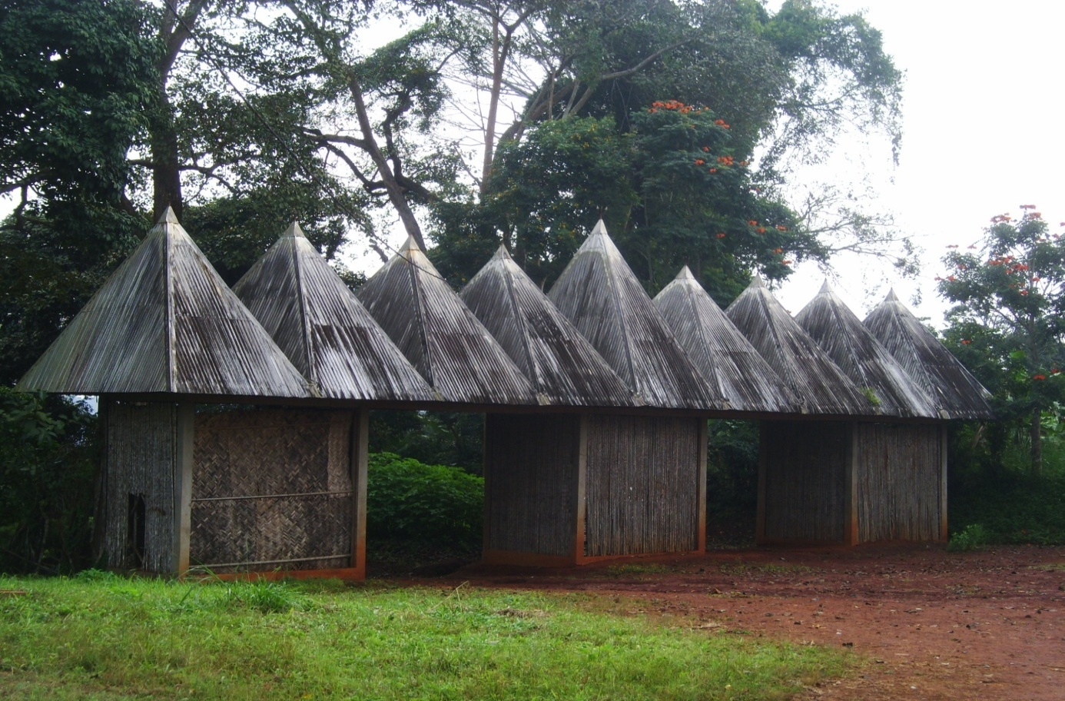
Palace of the Sultan-King of Bamoun, views of the Bamileke chiefdoms

Slide 8
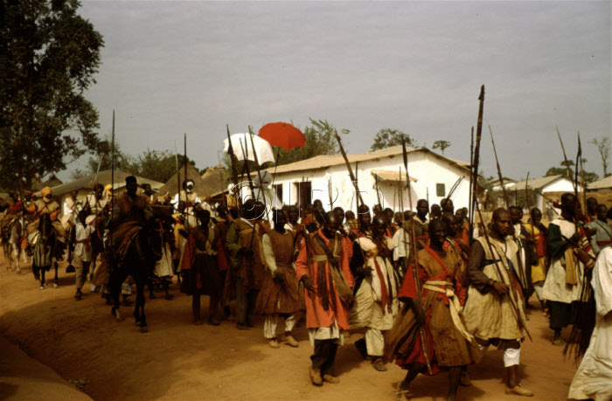
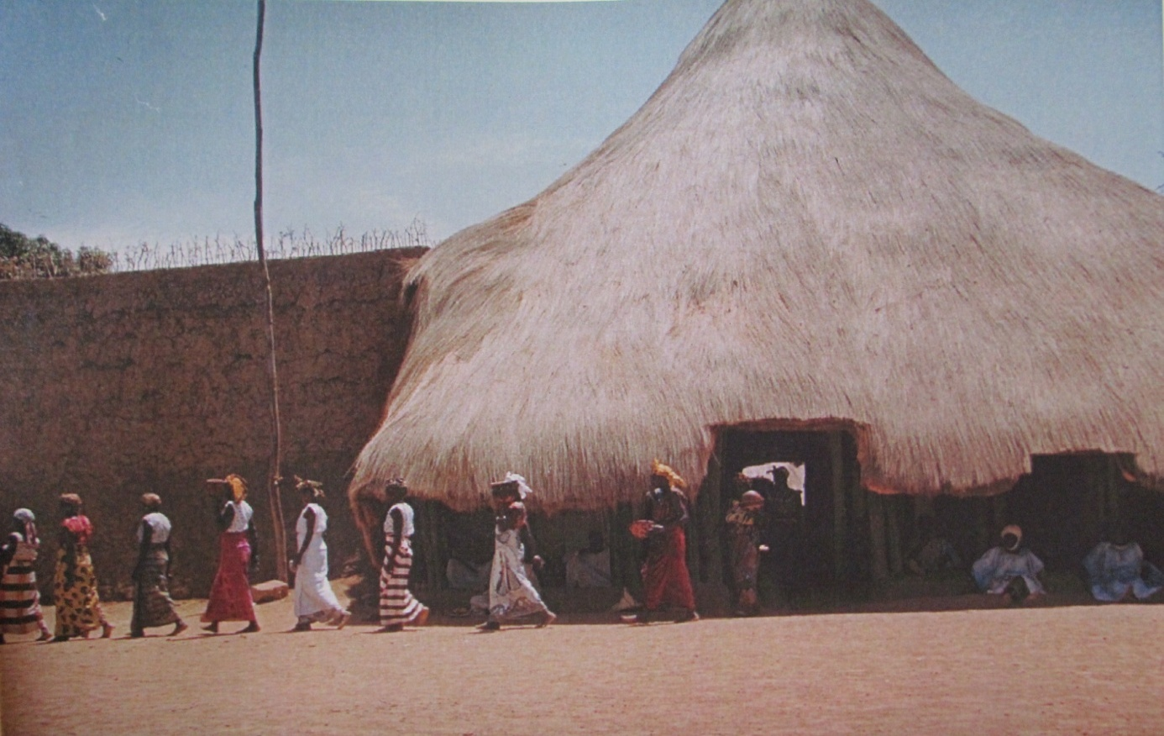
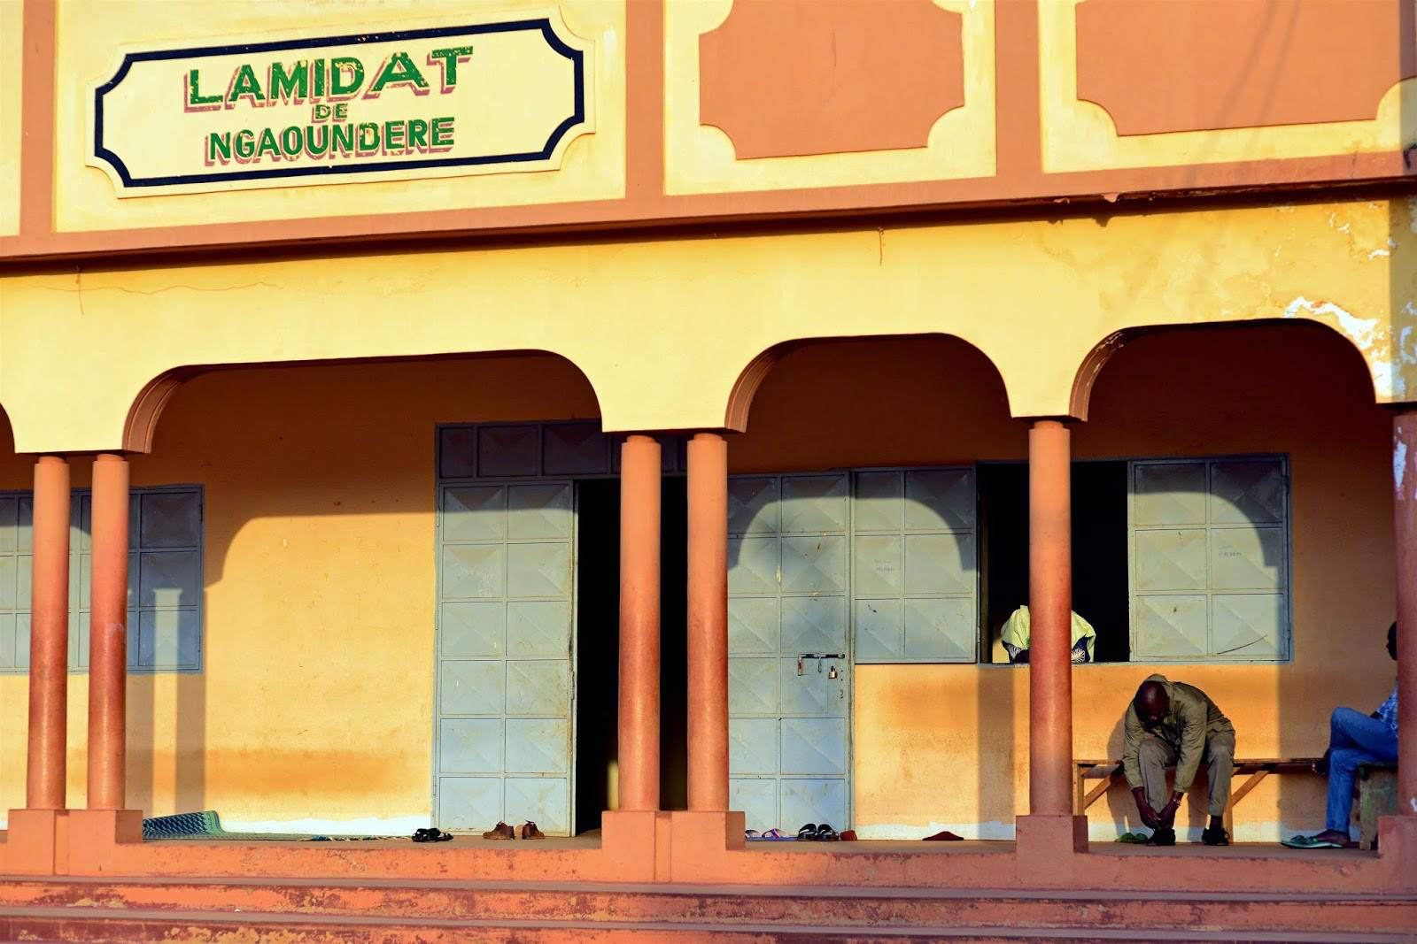
Procession of the Lamido of Ngaoundéré
A column of slave women leaving the Palace to collect sand (1955)

Slide 9
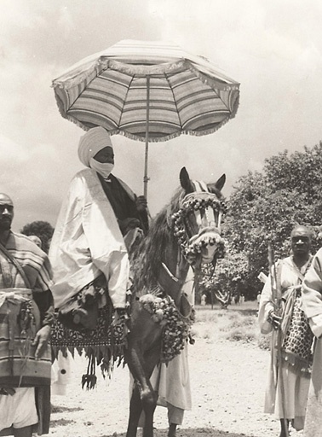
Lamido Iyawa Adamou
(Banyo), 1942-1966
Notes:
Cavalerie cuirassée de Ray Bouba. Les esclaves ont servi à acheter des chevaux, leur harnachement et leurs armures, pour faire encore plus d’esclaves. Eldridge Mohammadou, ONAREST.

Slide 10
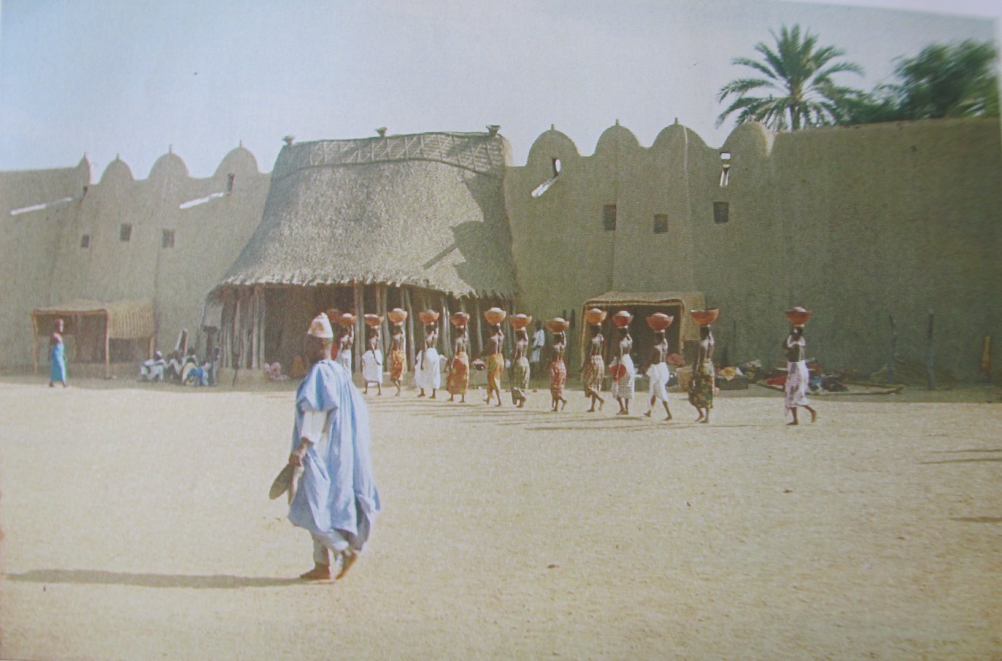
Main entrance to the Lamido (King) of Ray-Bouba’s Palace
(column of half-naked slave women)

Slide 11
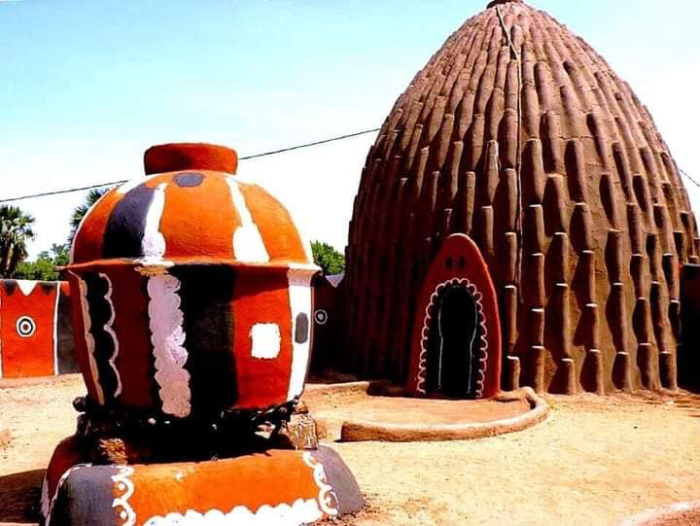
The Musgum hut: an architecture of resilience in the face of raids and fires (slave epic of Rabah, 1842-1900)

Slide 12
Camarones-Kamerun-Cameroons-Cameroun-Cameroon
Land of diversity
More than 250 tribes/ethnic groups
Cultural diversity
Geographical diversity
Historical diversity
Diversity in enslavement process too !
The summary of Africa

Slide 13



Slide 14
The TIKAR
Central Cameroon and Grassfields ethnic groups make up approximately 10 % of Cameroon's population.
This could be due to the high number of Tikar people who were kidnapped and sold into slavery in the Americas.
The Bamum people and other ethnic groups have also asserted their link to the Tikar people through Tikar rulers in the Kingdom of Bamum. However, the Kom, Nso, Bamum, Ndop-Bamunka, and Bafut peoples are the only ethnic groups that anthropologists and historians believe have a legitimate claim to Tikar lineage,
There are currently six adjoining Tikar kingdoms: Bankim (Kimi), Ngambé-Tikar, Kong (Nkong/Boikouong), Nditam (Bandam), Ngoumé, and Gâ (Ntchi).
"Bamum and the Tikar are renowned as great artists who create monumental sculptures of bronze and beads. Cultural exchanges between the Tikar and the Bamum have enriched both groups. For instance, the Bamum adopted numerous words from the Tikar language, as well as from other languages, including Bafanji, Bamali, and Bambalang."

Slide 15
Founding of Tikar kingdoms
In the late 14th century, two Tikar brothers, Tinki and Guié, founded two autonomous Tikar kingdoms: the Kingdom of Bankim (also called Kimi) at Rifum, and the Kingdom of Ngambé-Tikar. These lineages gave rise to Tikar princes and princesses who embarked on significant migrations, creating new dynasties.
In the first wave of migrations, Prince Ncharé (also called Njáré) founded the Kingdom of Bamum, Prince Doundje established the Kingdom of Nditam (also called Bandam) and ruled alongside Queen Mother Nduingnyi, Prince Kpo departed Nditam to found the Kingdom of Ngoumé, Prince G’Batteu created the Kingdom of Gâ, and Princess N’Gouen (also called Nguonso) established the Kingdom of Nso (also called Banso).
In the second wave of migration, Prince Mbli left Bankim to establish the Kingdom of Kong, while Prince Indie and Prince Ouhin migrated south, founding the villages of We and Ina, respectively. However, these settlements never developed into full-fledged kingdoms.
Fon Nchare Yen established the Kingdom of Bamum at Foumban in the late 14th or early 15th century,

Slide 16


Slide 17
THE BAMILEKE
Peoples of the Grassfields in Cameroon
Including Tikars, Bamoun and neighbouring Igbo of South-Eastern Nigeria
Bamiléké means "people of faith“
They do not refer to themselves as Bamileke but instead use the names of the individual kingdoms to which they belong or else refer to themselves as “grasslanders.”
The Bamileke languages are Grassfields languages that belong to the Southern Bantoid branch of the Niger-Congo language family
According to some Bamiléké oral traditions, they are descendants of a Mbum princess named Wouten (also called Betaka) who helped establish the Tikar fondom sometime in the 13th century after being expelled from Ngan Ha, the capital of Mbum following a succession dispute.
The Mbum who migrated to their current location from Northern Cameroon are the ancestors of all Grassfields people and now reside in the Adamawa province of Cameroon.
In the 17th century, the Bamiléké migrated further south and west under the pressure of the Chamba and Fulani people.
When Cameroon was colonized, the Germans and the British granted status and a certain amount of control to traditional authorities, such as the Fon. This was due to a colonial policy known as indirect rule. On the other hand, the French looked at Fons with contempt and were often suspicious of them.

Slide 18

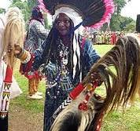
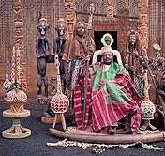
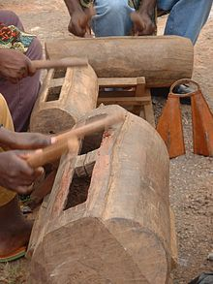
Culture, Traditions and Power

Slide 19
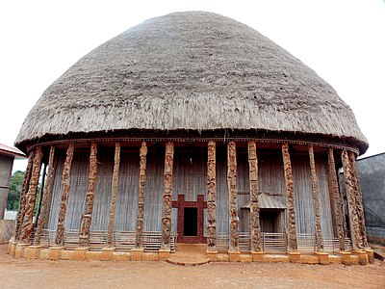
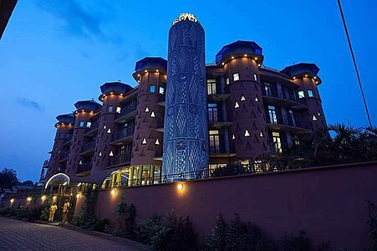
Ancien and Modern architecture
Bandjoun Zingana Hotel Bafoussam

Slide 20
SOCIOPOLITICAL ORGANIZATION
Bamiléké settlements follow a well-organized and structured pattern.
Houses of family members are often grouped together and surrounded by small fields.
Bamiléké settlements are organized as chiefdoms.
The chief, or fon or fong is considered as the spiritual, political, judicial and military leader.
The power of a Bamileke king, called a Fon, is often represented by the elephant, buffalo, and leopard. Oral traditions proclaim that the Fon may transform into either an elephant or leopard whenever he chooses.
The chief is also considered the 'father' of the chiefdom. He thus has great respect from the population.
The successor of the 'father' is chosen among his children. The successor's identity is typically kept secret until the fon's death.
The Bamileke trace their ancestry, inheritance and succession through the male line, and children belong to the fondom of their father. After a man's death, all of his possessions typically go to a single, male heir. Polygamy (more specifically, polygyny) is practiced, and some important individuals may have literally hundreds of wives. Marriages typically involve a bride price to be paid to the bride's family
The fon typically has 9 ministers and several other advisers and councils.
The ministers are in charge of the crowning of the new fon.
The Council of Ministers, also known as the Council of Notables, is called Kamveu.
A "queen mother" or mafo was an important figure for some fons in the past.
Below the fon and his advisers lie several ward heads, each responsible for a particular portion of the village. Some Bamileke groups also recognize sub-chiefs, or fonte.

Slide 21
RELIGIOUS BELIEFS
The dominant form of worship is still ancestral with most Bamileke practicing Veneration of the dead.
Death is always met with mystery, and the family is required to turn the body over to an examiner to determine the cause of death.
After this is completed, the family must gather at the home. Each member must step up to the totem and swear that they were not involved in the death of the loved one.
It is believed that if someone in the room really is the murderer, the totem will trap their spirit forever.
To satisfy the Ancestors, the person believed to be a murderer must perform a special ritual that consists of the pouring out of libation during the burial ceremony. The family will then gather the wet earth and shape it into a circle.
This is seen as a metaphorical skull of the deceased, blessed by libation.
The Bamileke also believe that the Ancestor's spirit still remains within the actual skulls of the Ancestors as well, so they keep possession of them.
The oldest male in the family keeps the skulls of both male and female ancestors in a dwelling that the family built and a diviner has blessed.
In the event that a skull is not well preserved, a special ritual must be performed that consists of the pouring out of libation.
The Bamileke are known for elaborate elephant masks used in dance ceremonies or funerals to show the importance of the deceased person.

