Slide 1
Finding Ancestors Using Genetic Genealogy: Louis Childers Story
Dr. Alva Burkhalter, 2022

Slide 2
What is Genetic Genealogy?
Genetic genealogy is the marriage of your historical documents to data stored in your genes. Utilizing both sources of information, you enhance your ability to understand your ancestry.
There are many reasons a person takes a DNA test, and each search may start at a different point due to the information available at the beginning. To determine where to start, look at what you know to be correct and what information is still missing. That will tell you how to begin.

Slide 3
What Does a Y-DNA Test Tell You?
Y chromosome test - paternal or father-son inheritance.
We each have two sex chromosomes. X is female and Y is male. If you have 2 X’s you are female. If you have an X and a Y, you become a male because the Y chromosome is dominant.
The father supplies the Y chromosome; therefore, he determines the sex of the child. The surname is passed from father to son, so you can determine common male ancestors.
If you and another male have the same Y chromosome and also show an autosomal kinship, you probably share a common male ancestor in the not too distant past. If you only share a Y chromosome and no kinship, the male ancestor may be anywhere in the distant past.

Slide 4
What is an Autosomal DNA test?
This is the type of test done by most ancestry commercial tests. It looks at all of our DNA except our sex chromosomes and our Mitochondrial DNA. This is usually over 99% of our total DNA.
Do they test your entire genetic code? No, because we are all (99%) alike. Their test is designed to test only those areas where we may have a letter change which results in a different amino acid that may cause some physical or other difference.

Slide 5
What Does an Autosomal DNA Test Tell You?
The more DNA you and another person have in common, the closer you are likely to be related. Some tests will be exact, but some may vary due to chance.
The exact tests include parent/child and identical twins. A child will always be 50% like the parent. Identical twins will be 100% alike. Tests based on chance are similar to flipping a coin. Siblings are normally 50% alike; first cousins usually 25%; second cousins about 12.5%; and third cousins 6.250% alike. Notice that in each generation the relationship is cut in half.
Note that if you share only one common parent, the relationship starts at only half as much. Half siblings are only 25%; half first cousins, 12.5 %; and etc. Half something usually means you share only one parent or common ancestor. Once removed means a child of that relative.
Some relationships may be identical but are shared by people in different generations. A first cousin and an aunt or uncle are both 25%. Usually, the testing agency will provide suggested relationships based on most likely to least likely. Your task is to look at the relationship and other factors you learn through genealogy research to figure how that person fits into a family tree.

Slide 6
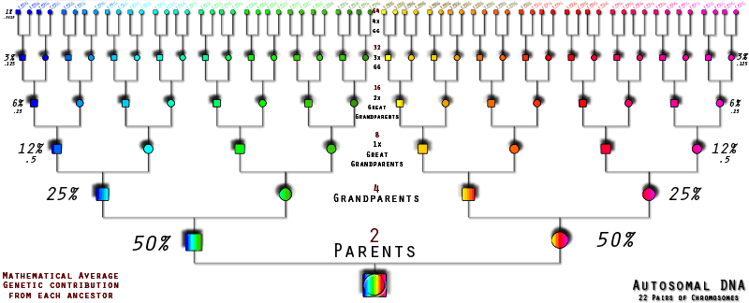

Approximate Generations

Slide 7
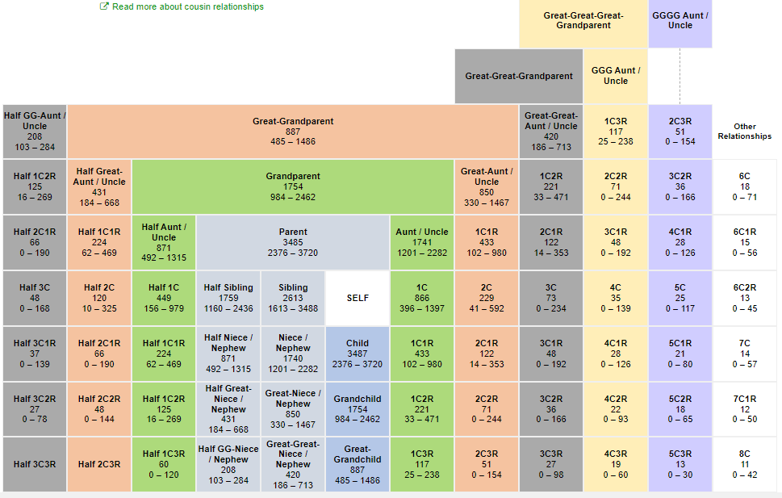
Possible Relationships Based on Shared DNA
DNAPainter.com

Slide 8
Louis Childers’ Y-DNA Story
How I find different information and sources often not used in genealogy research

Slide 9
Louis Childers’ Great Grandfather - Percentage of Black and White Heritage
I speculate that Louis’s great-grandfather was between 60 and 70 percent white based on the following:
GENERATION 1: Hugh Reese had a daughter named Mariah with his white wife. He also had a daughter with his black slave. The black daughter is 50 % white and is Mariah’s half sister.
GENERATION 2: Hugh Reese’s black daughter was given to Mariah. Mariah married Henry Scott. The black daughter had a daughter with a male slave. That daughter should be about 25% white. She is the half-first cousin of Evelyn Scott who is Mariah’s daughter and married John Lawson Burkhalter.
GENERATION 3: John Lawson Burkhalter had a son with the black slave given to Evelyn Scott, his wife. That son received 50% white genes from John Lawson Burkhalter and likely half of the 25% white genes from his mother. This is assuming that the black male in GENERATION 2 is 100% black (which itself is questionable). Therefore, Louis’s grandfather was probably at least 62.5% white or more.

Slide 10
Different Generations of the Reed and Burkhalter Families
First Generation
John Burkhalter, Warren County | Hugh Reese, father of Louis’s female distant ancestor, Warren County
Second Generation
Jacob Burkhalter, Mary Lawson (wife) | Jeremiah Burkhalter, Dorcas Reese (wife) | Henry Scott, Mariah Reese (daughter of Hugh Reese)
Third Generation
John Lawson Burkhalter |  | Evelyn Scott (wife)

Slide 11
Louis’ DNA Relatives with Burkhalter Surnames
Genealogical research shows that all these relatives of Louis have John Lawson Burkhalter, Sr. as their common ancestor
Louis Childers | R. P. (Poore) | Turner Trippe III
(Louis’s Father), Lewis Childers | Private (mother) | Turner Trippe Jr.
(Louis’s Grandfather), Napoleon Childers | Latimer Hall Eugenia Lawson Burkhalter | Turner Trippe Lillian Burkhalter
(Louis’s Great Grandfather, Lewis Childers | John Lawson Burkhalter Jr | Thomas Jefferson Burkhalter
 | John Lawson Burkhalter Sr.

Slide 12
Thank You

